Slide 1
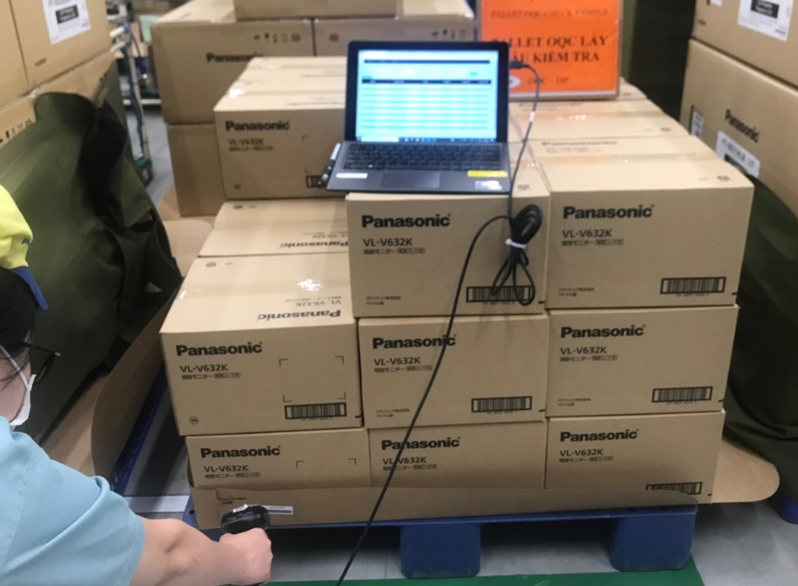
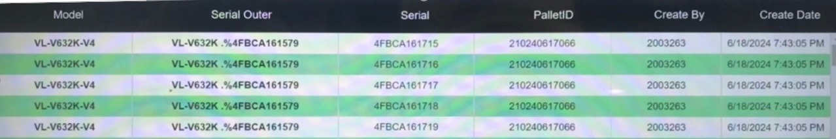
Review OQC sampling method
Assy
Packing
ID Pallet station
FA warehouse
SCM warehouse
Shipment
Case 1
OQC
OQC
Case 2 : For HC400 serries
ID pallet issue in FA process
Case 1 : OQC pick up sample before ID pallet ➔ Return to ID pallet station
( ID pallet station : Reading Inner carton S/N - Outer carton S/N → issue ID pallet )
→ No risk for wrong packing inner box S/N and outer box S/N
→ Need to review OQC area how to control Product S/N and Inner carton S/N
Case 2 : OQC pick up sample after issue ID pallet ( Ratio : 2% )
Pickup sample
Record ID pallet
OQC sampling check
Return to SCM W/H
Step 1: Recorded ID Pallet and
S/N carton box by excel file
Step 2: Matching ID pallet and Outer
carton before return
No risk for return wrong pallet
Need to review OQC area how to control Product S/N - Inner carton S/N – Outer S/N

Slide 2

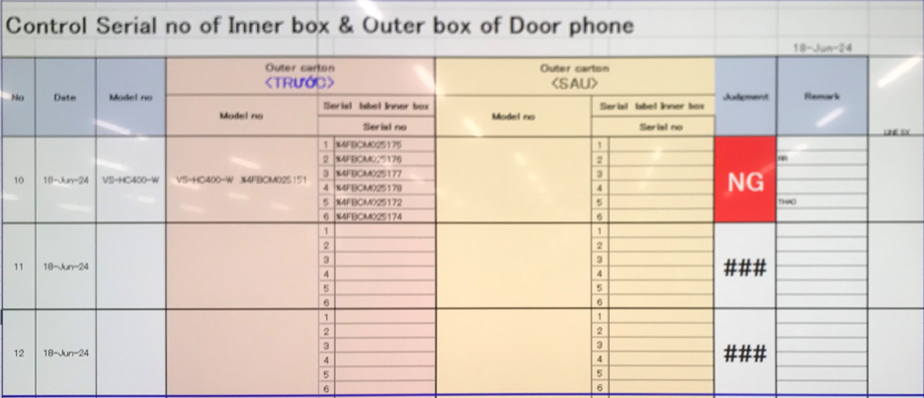
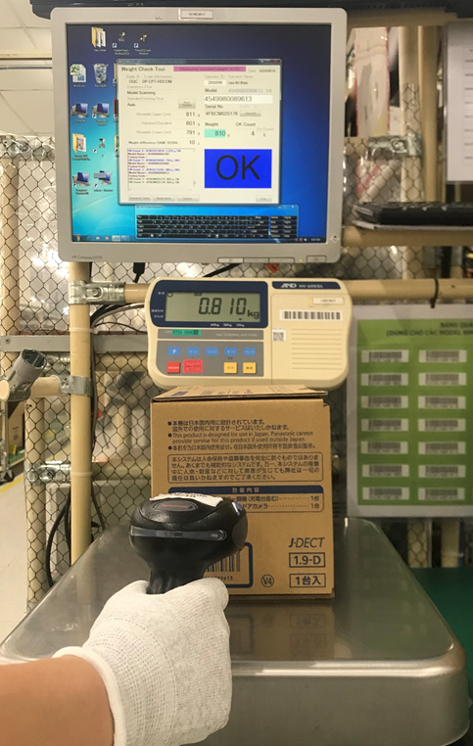
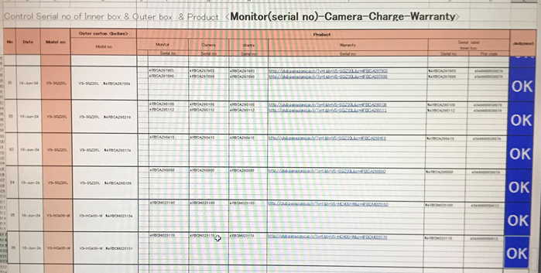
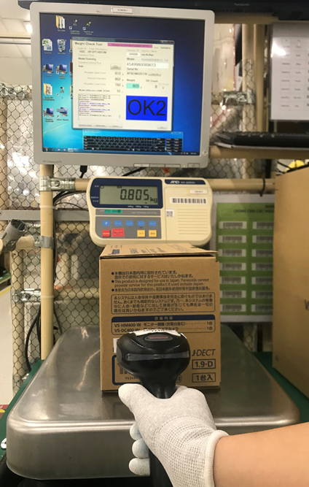
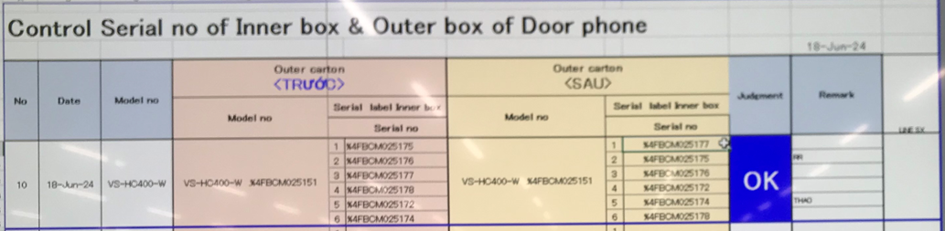
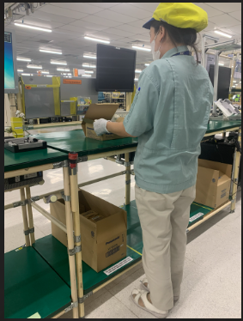
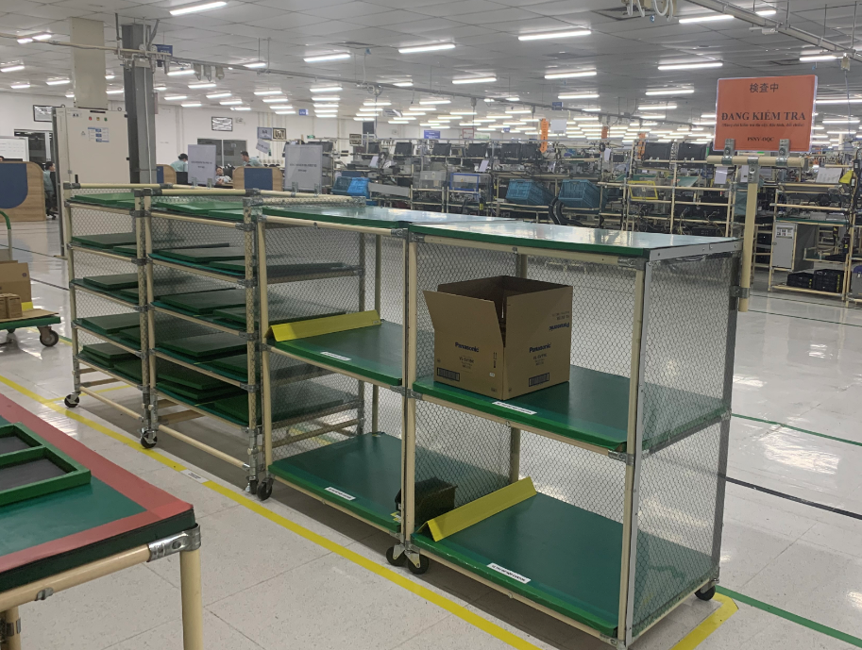
Review control sample at OQC area ( System control )
Pick up sample
Reading barcode Inner/Outer
Weight check 1st
OQC
inspection
Reading BC
Product / Inner
Weight check 2nd
Reading barcode
Inner/Outer
Return to Pallet
Reliability
Confirm S/N Outer & all inner boxes
Accessory control
Numbering control & Separate area
Product / Warranty/ Manual & Inner box
Accessory control
Confirm S/N Outer & all inner boxes
*In case not matching Product / Warranty/ Outer & Inner ➔ Can find out before packing
Physical control
1person – 1 model
– 1 table
Same time inspection
Reliability test area separate control and clear indication
After reliability test , product return to check full OQC item

Slide 3
Project: Link weight check system FA-SCM-OQC
FA
Pallet ID
SCM
Shipment
- Weight check
- Pro date/Model/Q’ty
- Issue FG control sheet
- Issue Pallet ID: Model/Q’ty/SN
- Issue Movement slip <SAP>
- Read Pallet ID Model/Q’ty>
- Take out FG control sheet>
- Compare FG & WMS
- Read Pallet: <Model/Q’ty>
- Take out FG control sheet
- Compare FG & WMS
CURRENT SITUATION
OQC
- Sampling pick up
Additional
Additional
Additional
Additional
① Add OQC :
Input sampling plan
Input Sampling product & Serial No
② Indication OQC situation:
Input Sampling result
Input total judgment All lot.
→ Send result by Email auto
③ QC inspection result:
Reading Pallet ID to check OQC result
Indicate OK lot
④ Function: If OQC judgment NG or Not yet
Stop next step
< PSNV/ Jupiter >
Study to link weight check & WMS
REQUEST
MERIT
Save:
8,000min/month
4000 paper
Save:
Reduce 2pax
990H/year
Save:
4,000 min/month
Note: Model not have S/N → Control as current method

Slide 4
1/1
Project: Link weight check system FA-SCM-OQC
◆Before
◆ After
FA
OQC
SCM
FA
Link
OQC
Link
SCM
. No indicate shipment priority
. No indicate result timely
. Cannot use weight system → compare S/N by manual
. Update OQC result not timely.
. Loss time to come to SCM for chop stamp.
. Loss time to confirm stamp by visual check
. Indicate result timely
. Indicate shipment priority
. Use weight system → auto compare S/N
. Online update OQC result & Save time to come to SCM for chop stamp
. No need check stamp by visual
. Confirm OQC result by system
Target improve:
Prevent wrong packing leakage out to market
△ 2pax for stamp by manual
2pax
OQC Issue
Risky point : Wrong packing pass to market by control offline
Loss time to confirm production result & Shipment schedule : 90sec*150lots=3.75H/day.
2pax/ day need to follow chop stamp in warehouse.
Improvement: Link system from FA-OQC-SCM
Prevent wrong packing.
Save time : 3.75H/day ~ 990H/year
Save manpower : △ 2pax for stamp ~ 12K$/ year

